Slide 1

What Mr. Spock would possibly say about modern unit testing: pragmatic and emotional overview

Slide 2
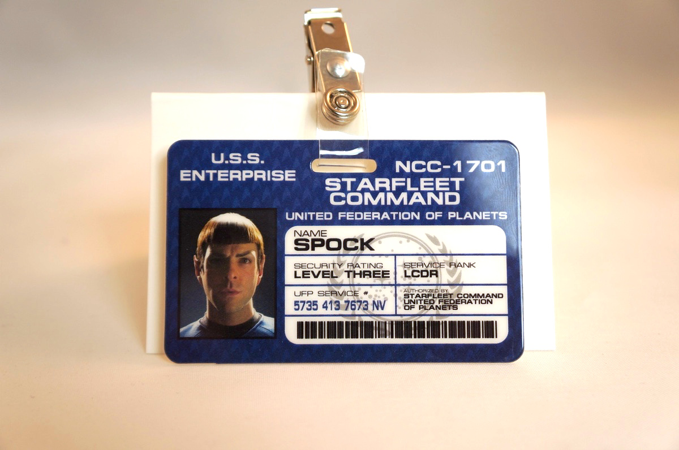
About me
Yaroslav Yermilov
Senior Software Engineer
EPAM Systems
Work on Big Data project
But responsible for test automation for
the last 2 years
Out of office is a big Groovy ecosystem fan
So the topic choice is obvious

Slide 3
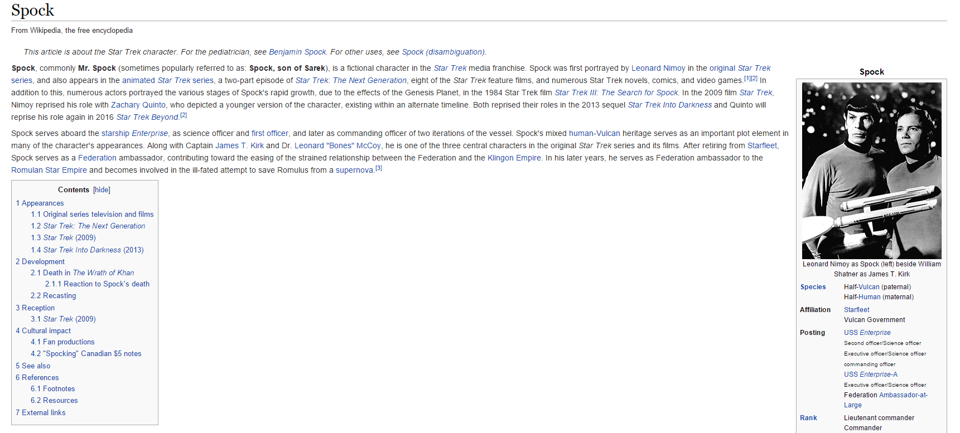
About Spock

Slide 4
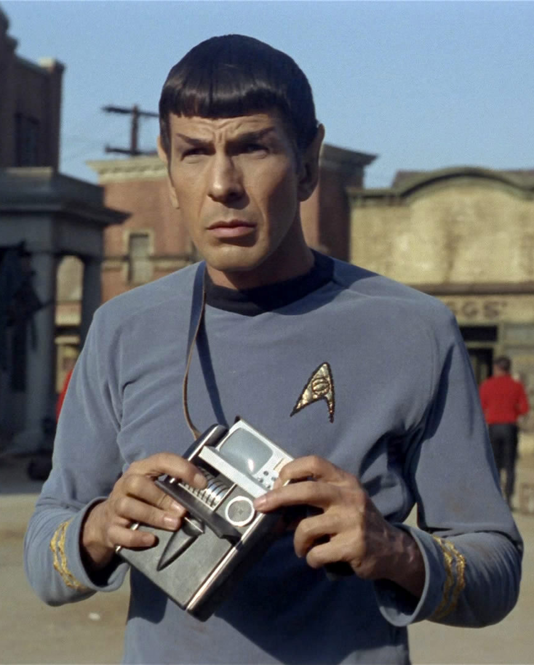
Questions
What’s about modern unit testing?
Why try Spock?
How to start with Spock?
Advanced and hidden features
What JUnit/TestNG/Mockito offers instead?
Why use Spock?
Why do not use Spock?
When use Spock?

Slide 5


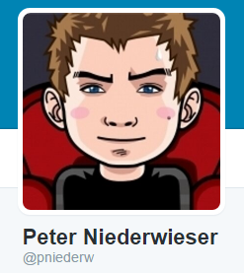

Disclaimer

Slide 6
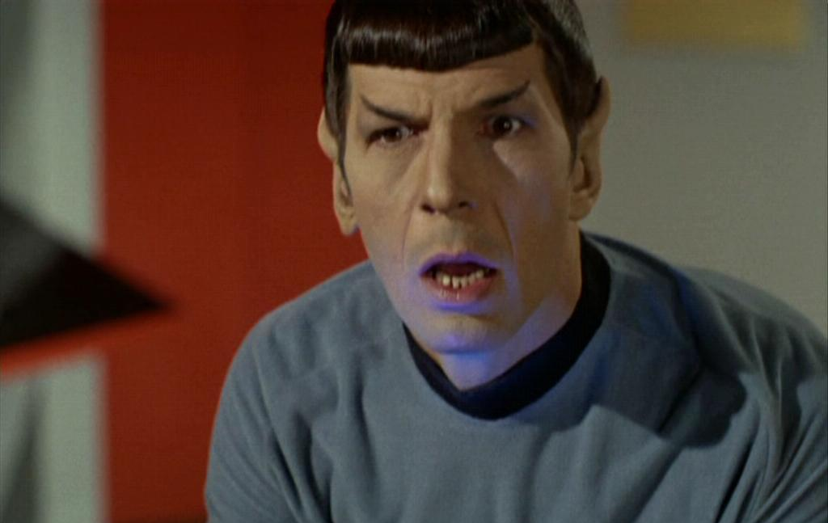
What’s the problem?

Slide 7

Better to test before going to production

Slide 8
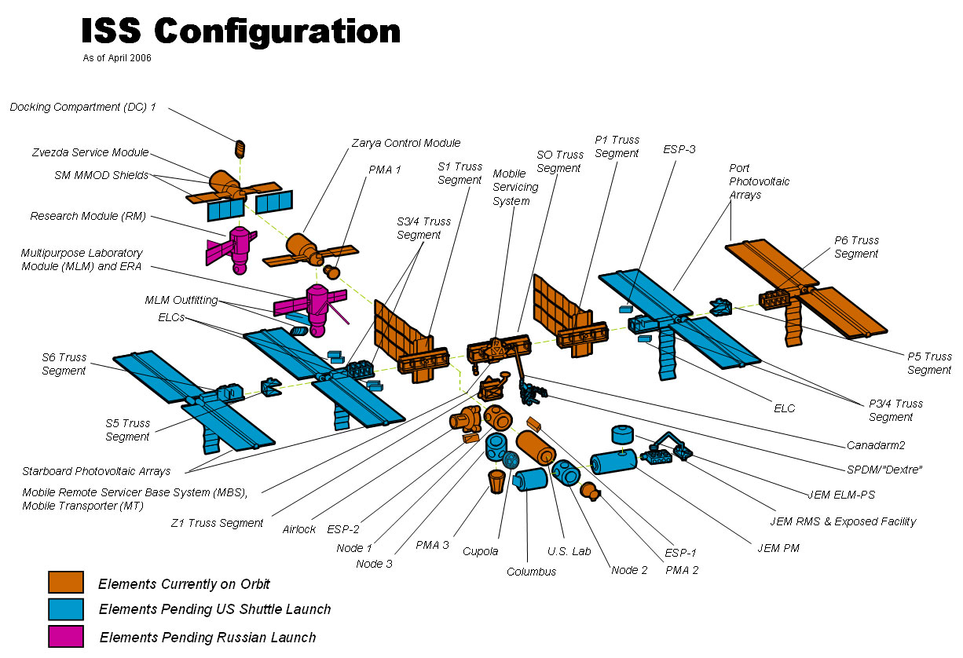
Firstly, to unit-test

Slide 9
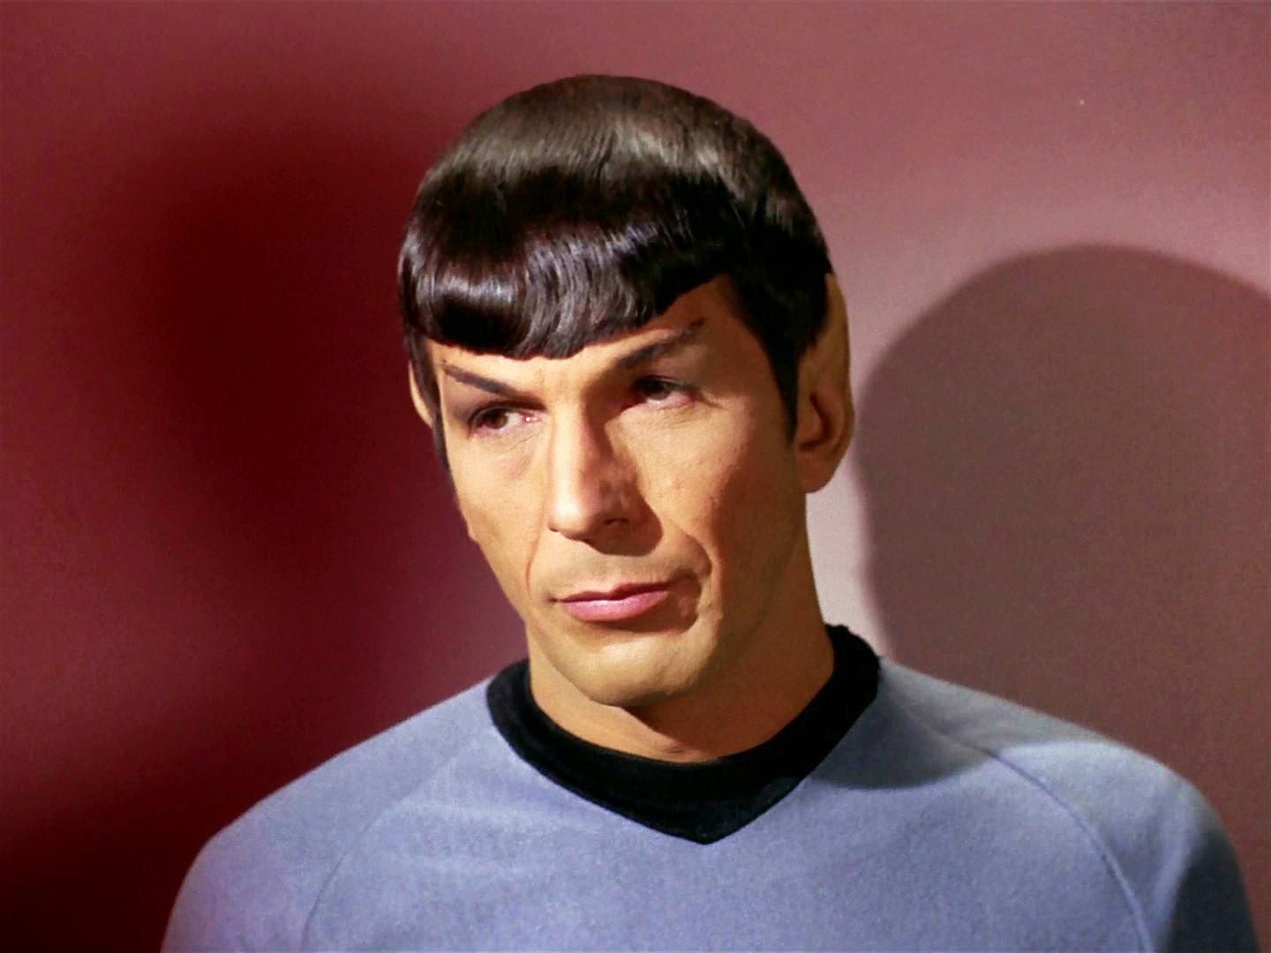
So what?

Slide 10

JUnit?

Slide 11
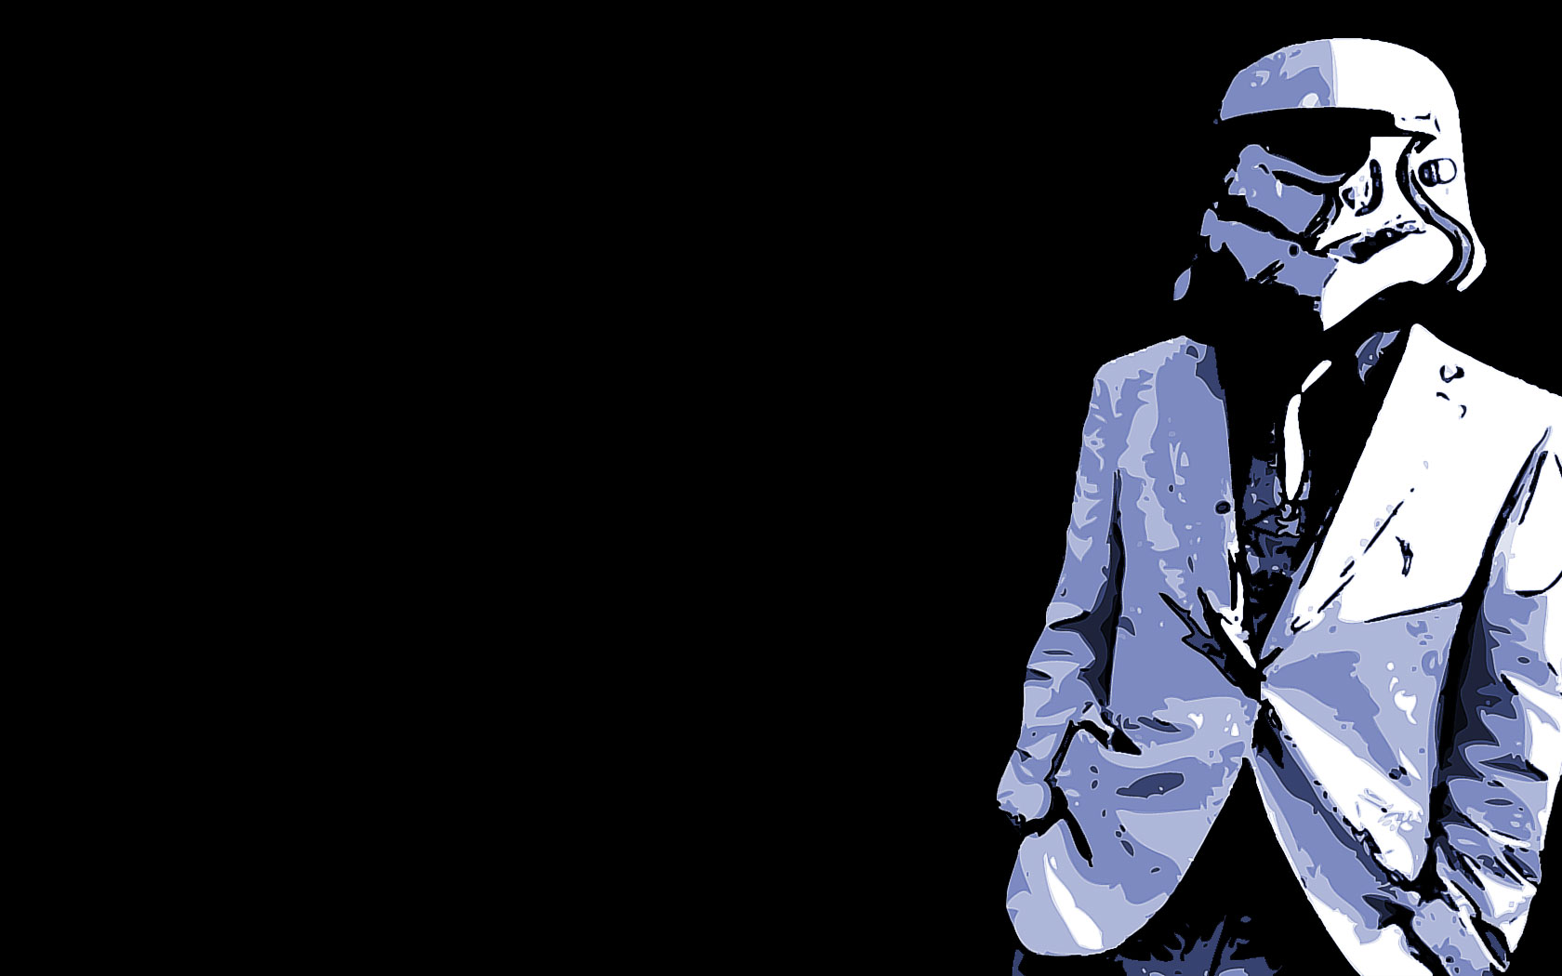
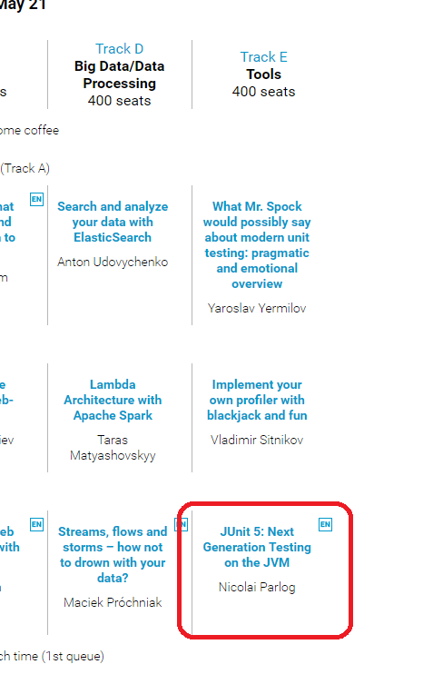
JUnit 5?

Slide 12
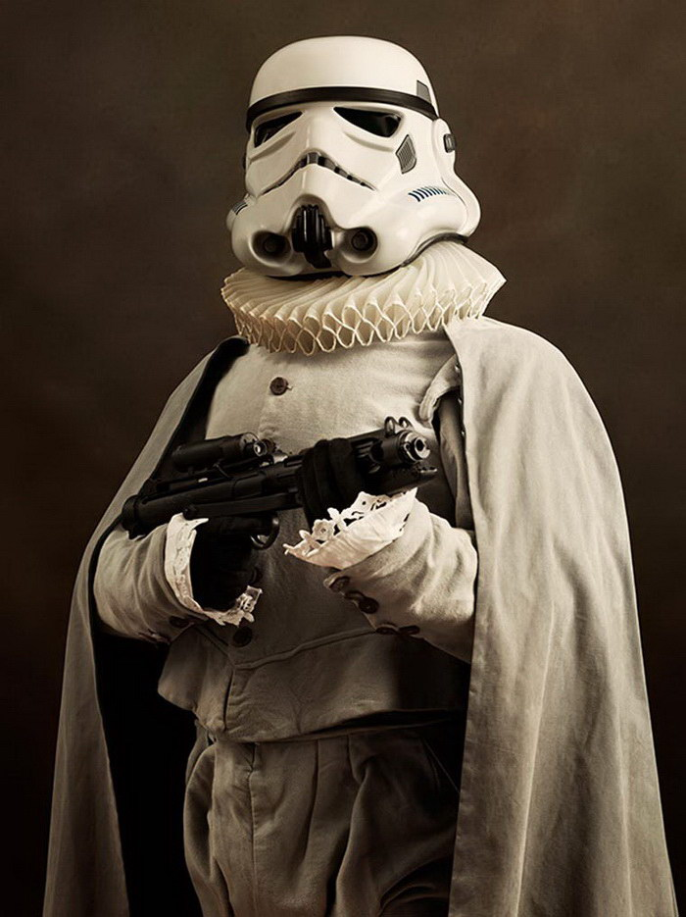
JUnit 3?

Slide 13
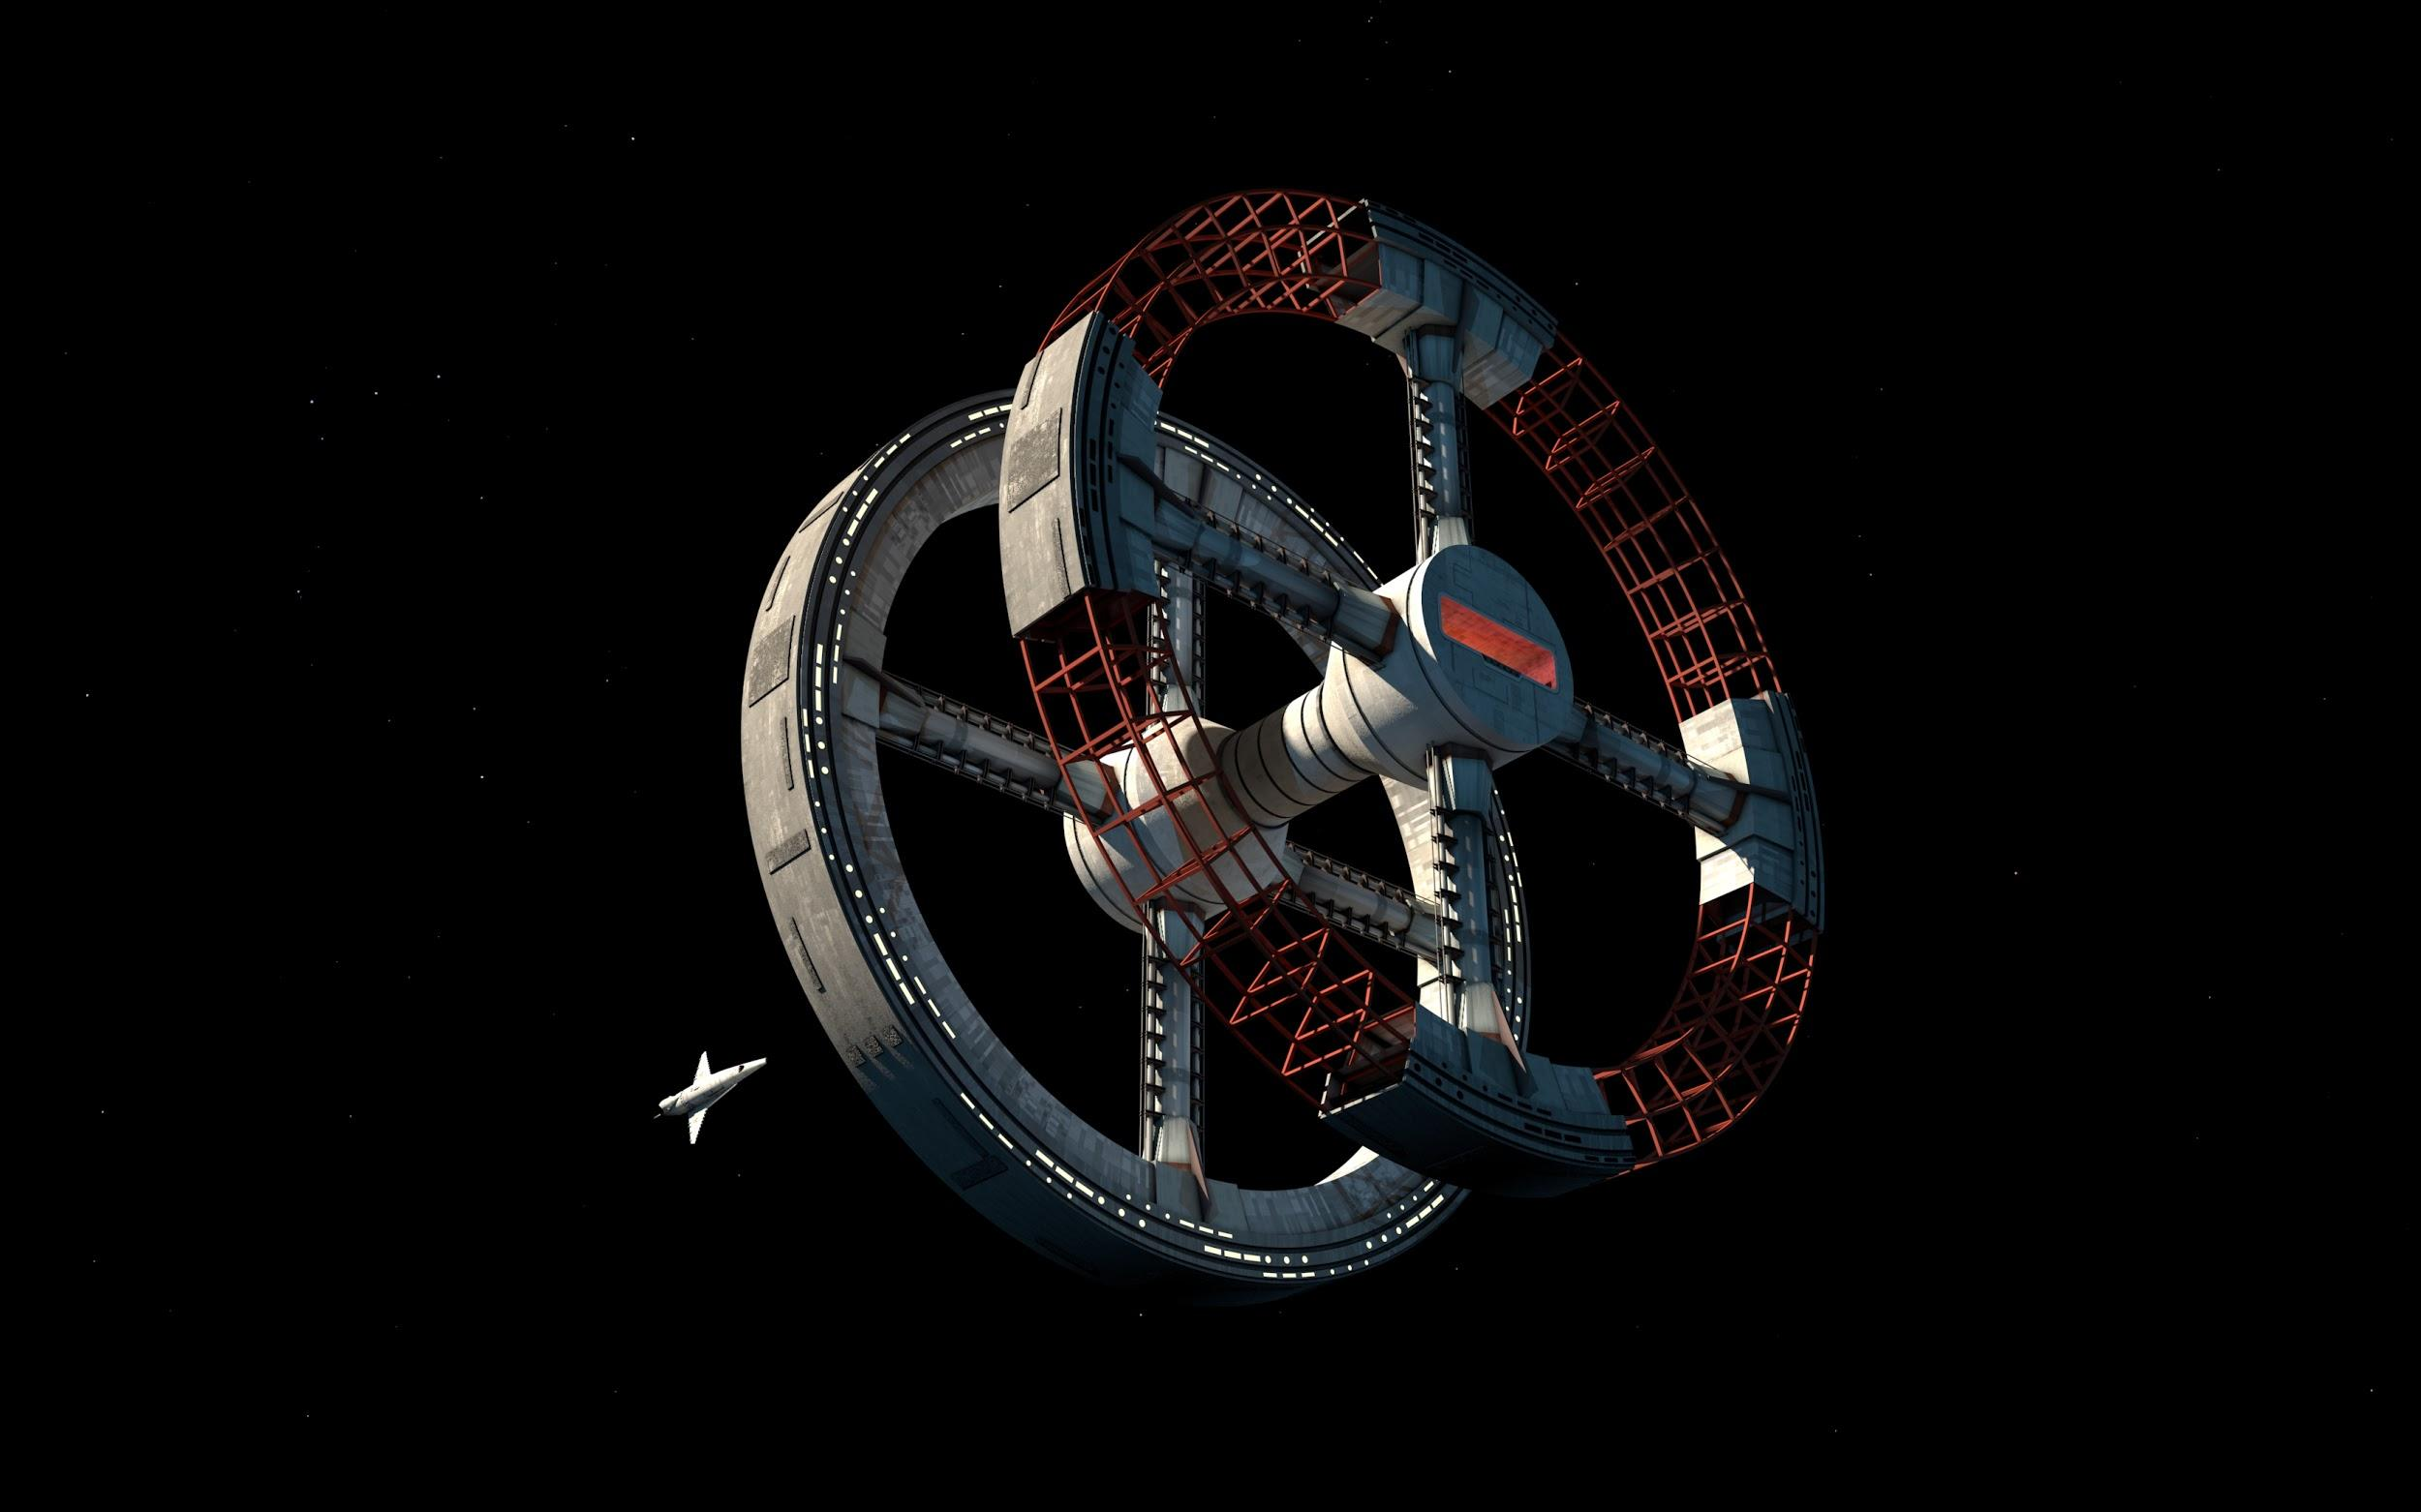
TestNG?

Slide 14

Unit testing framework on steroids?
Hamcrest
AssertJ
Google Truth
Mockito
PowerMock
JMockit

Slide 15

Spock?

Slide 16

Something odd?
Cucumber
J8Spec JGiven

Slide 17
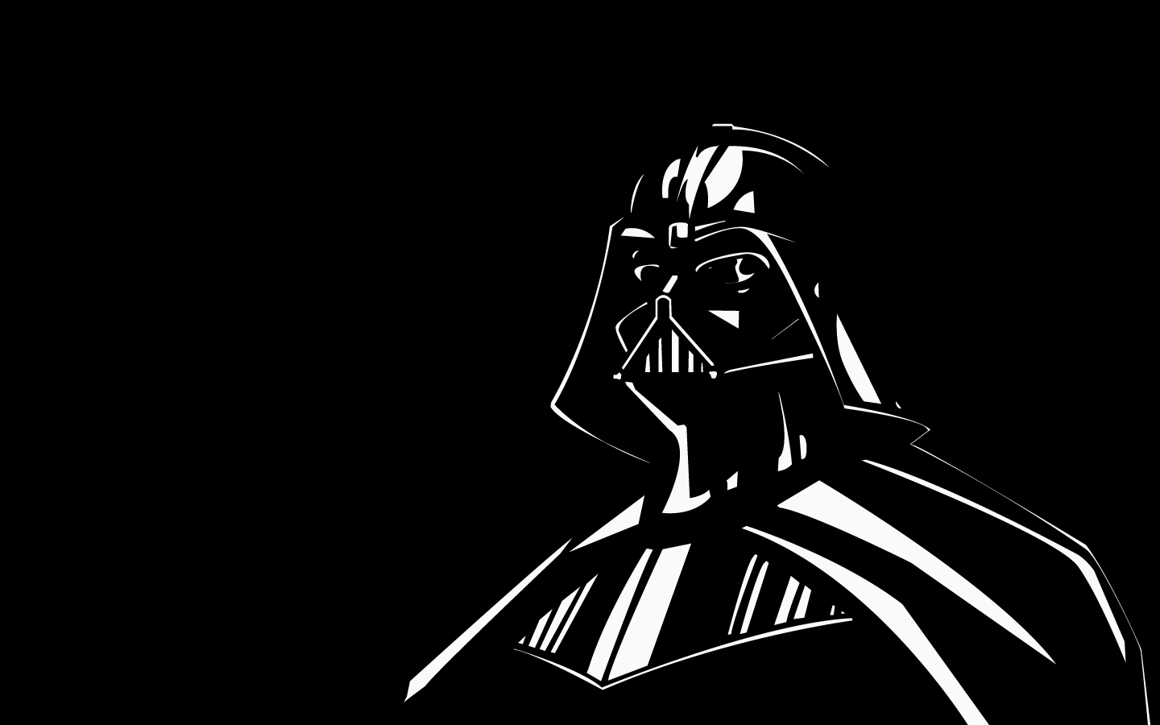
Nothing?

Slide 18
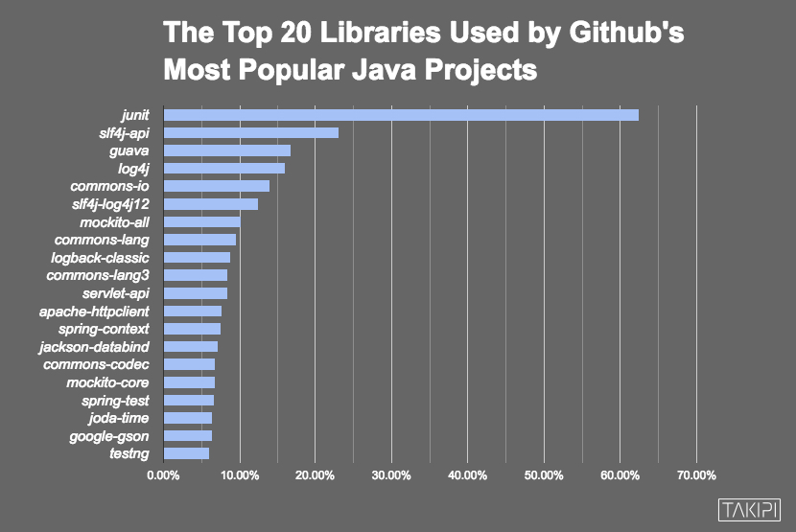

Slide 19

Automated testing
is a great concept

Slide 20

But have you ever felt like it’s frozen for the last years?

Slide 21
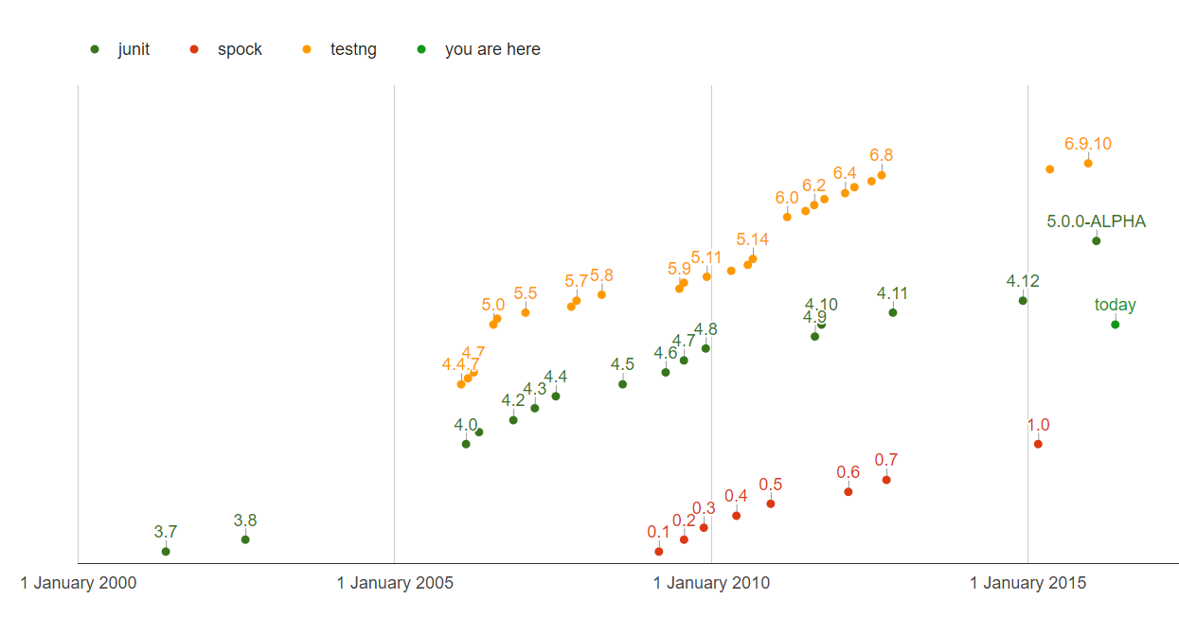
QUIZ: How many test framework releases we had since 2013?

Slide 22

So why don’t try Spock?

Slide 23

Spock is the next generation testing framework

Slide 24
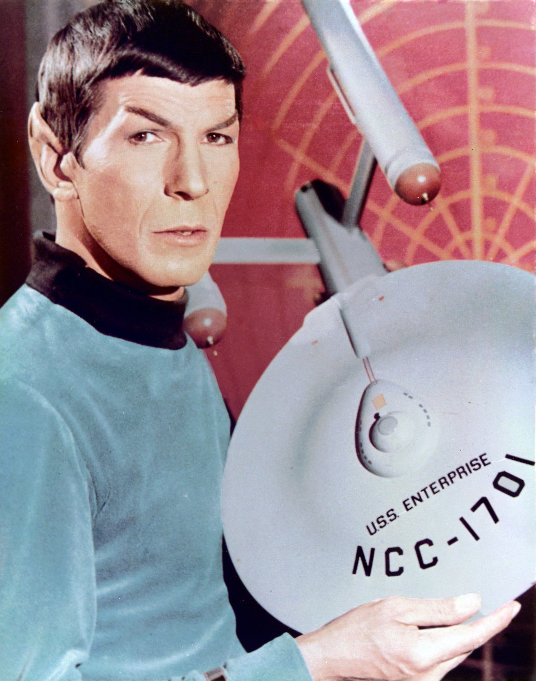
Spock is Enterprise ready

Slide 25
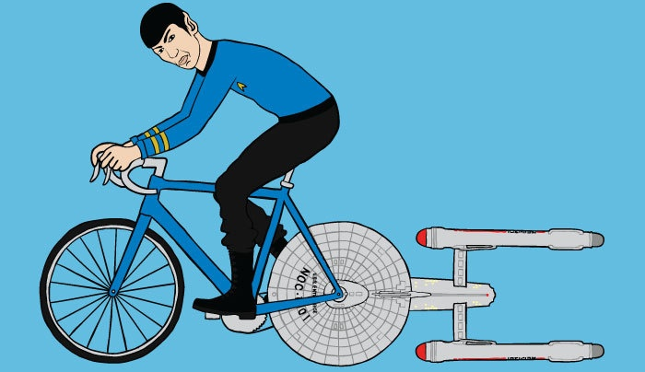
Let’s go!
https://github.com/yermilov/spock-talk

Slide 26
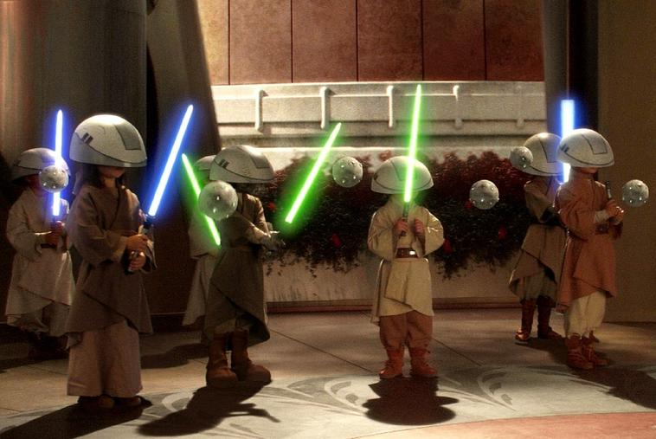
Episode I: Every journey starts somewhere

Slide 27
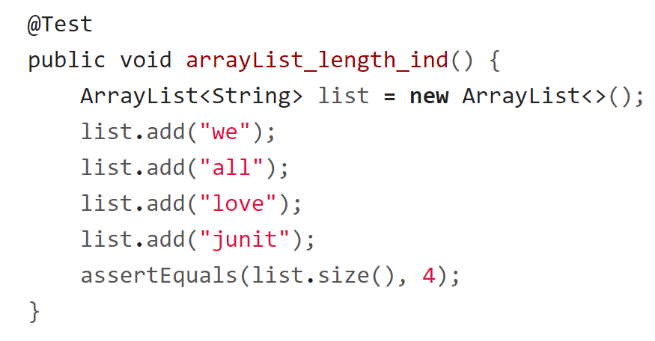
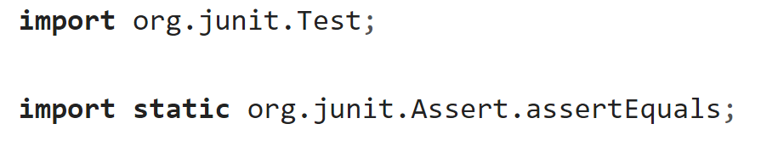
Episode I: Every journey starts somewhere

Slide 28
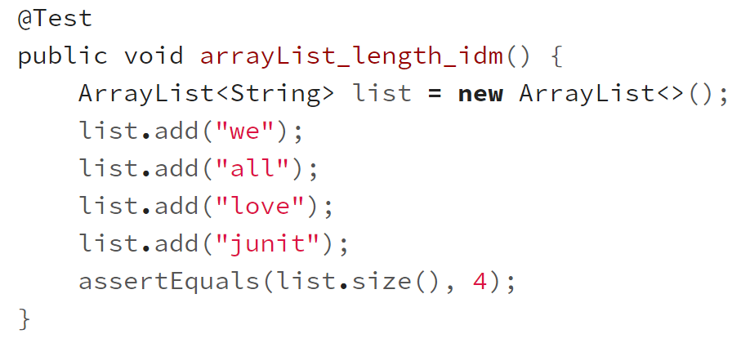
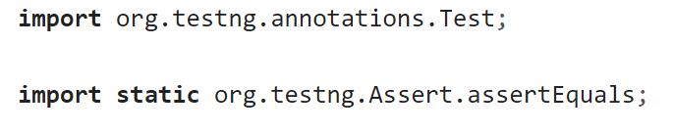
Episode I: Every journey starts somewhere

Slide 29
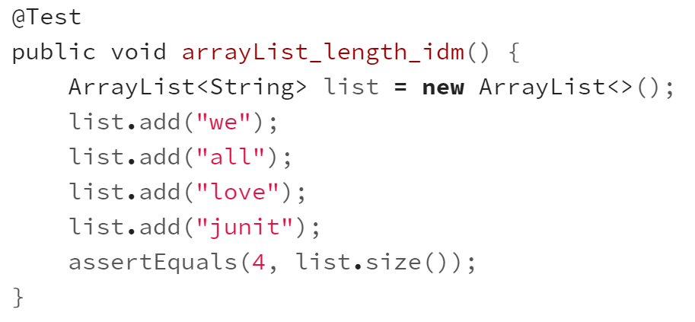
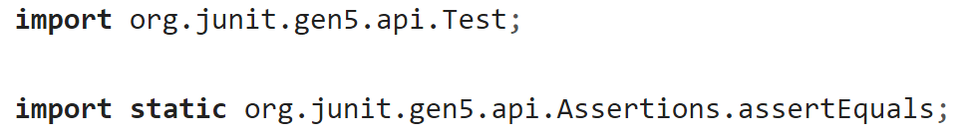
Episode I: Every journey starts somewhere

Slide 30
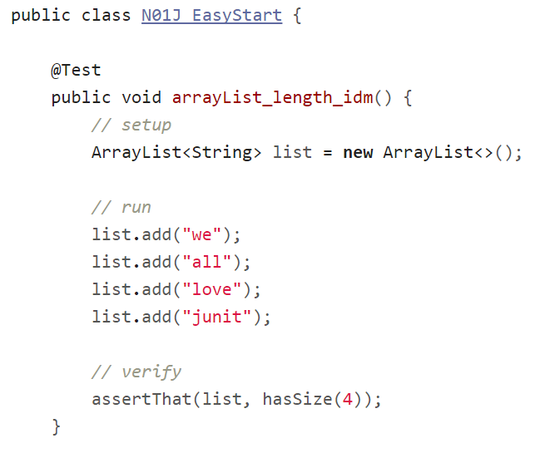
Episode I: Every journey starts somewhere

Slide 31
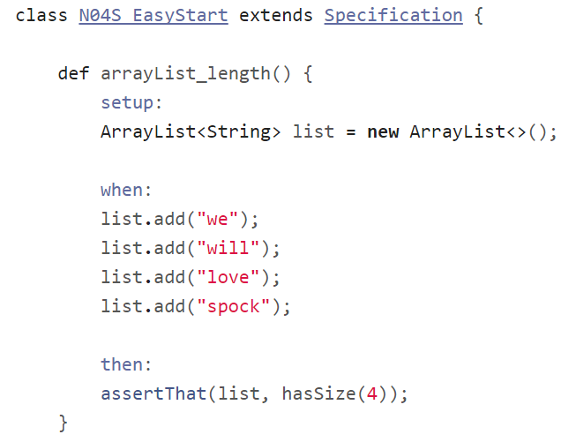
Episode I: Every journey starts somewhere

Slide 32
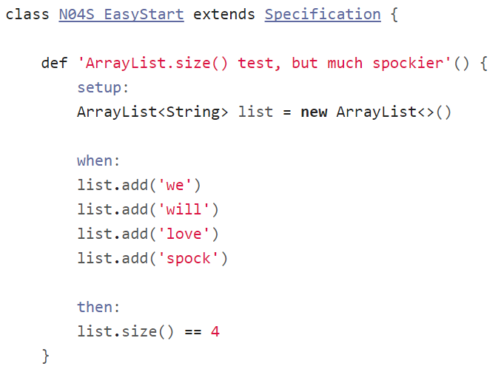
Episode I: Every journey starts somewhere

Slide 33
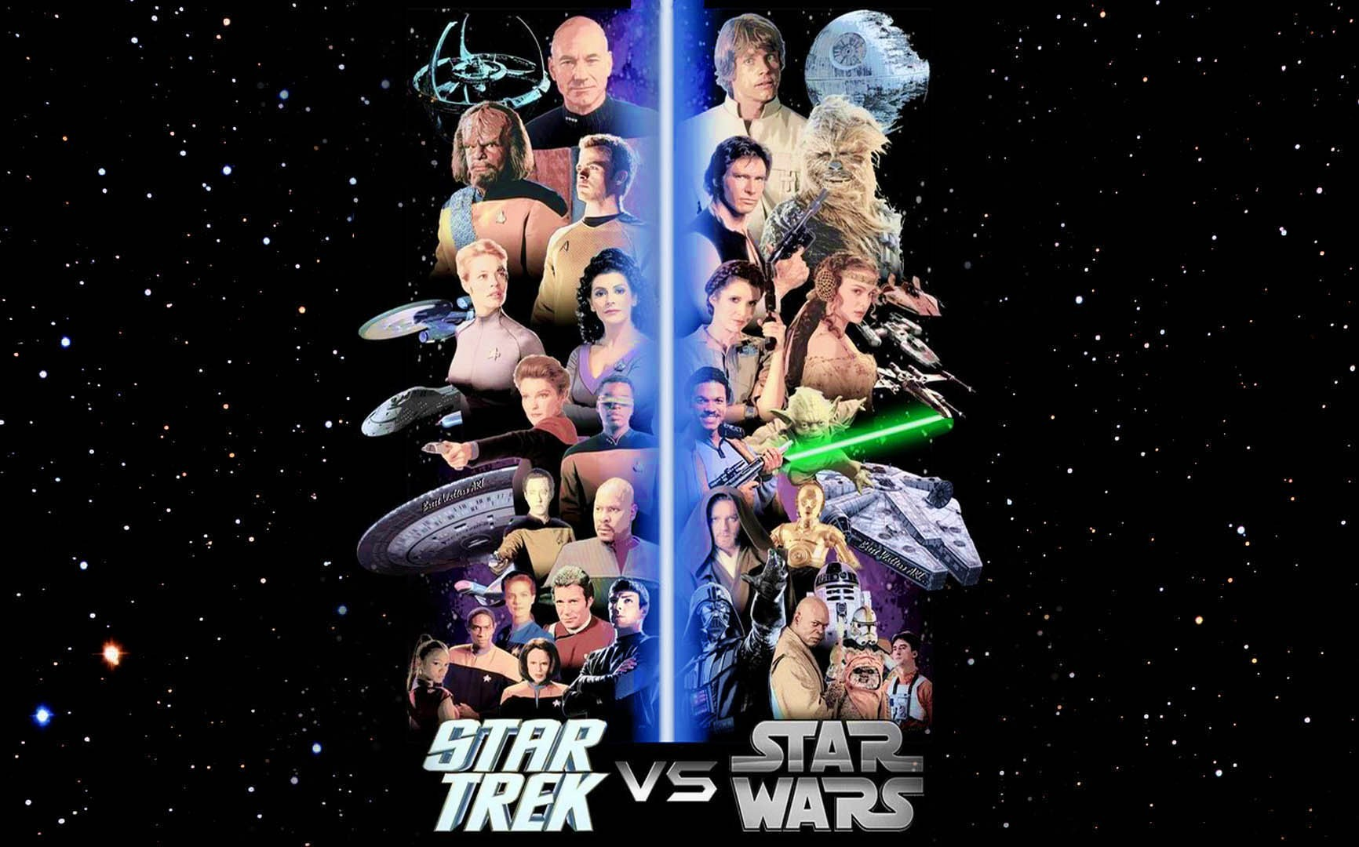
Episode II:
Assertions

Slide 34
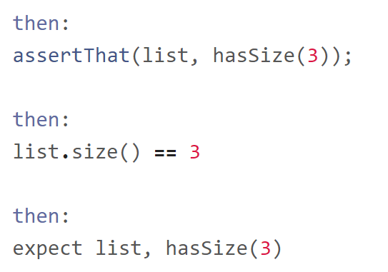
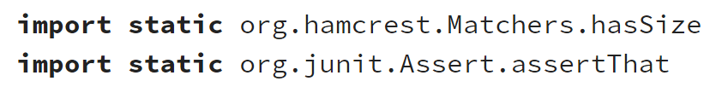
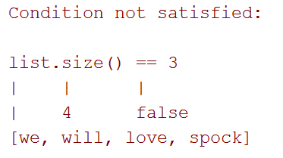
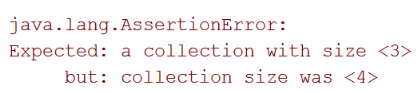
Episode II: Assertions

Slide 35
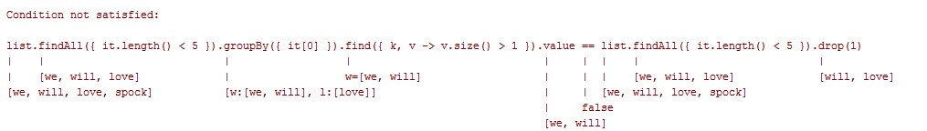
Episode II: Assertions

Slide 36
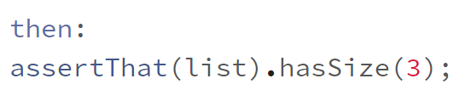
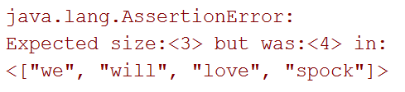
Episode II: Assertions

Slide 37
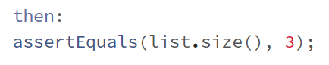
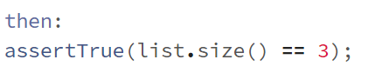
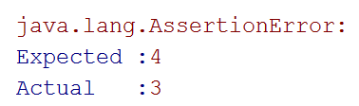
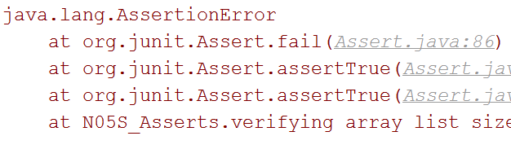
Episode II: Assertions

Slide 38
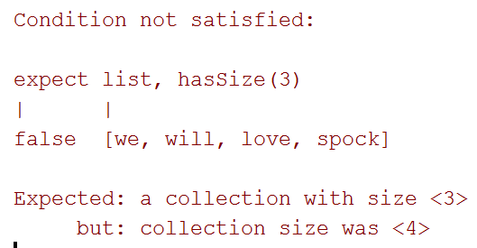
Episode II: Assertions

Slide 39
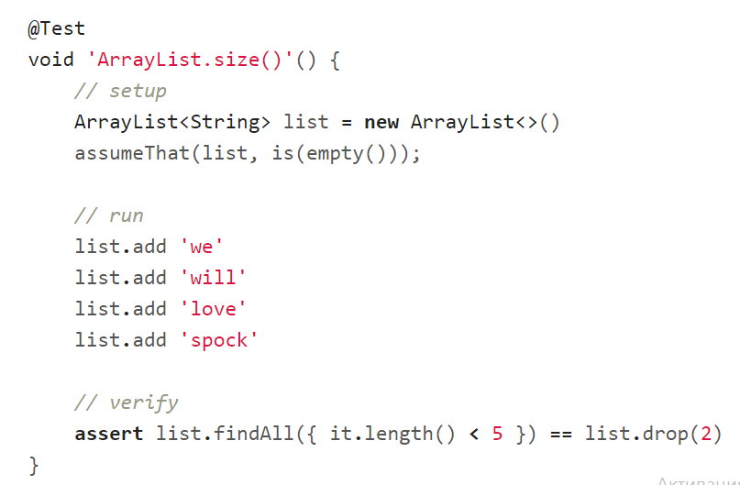
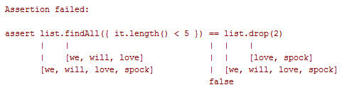
Episode II: Assertions

Slide 40
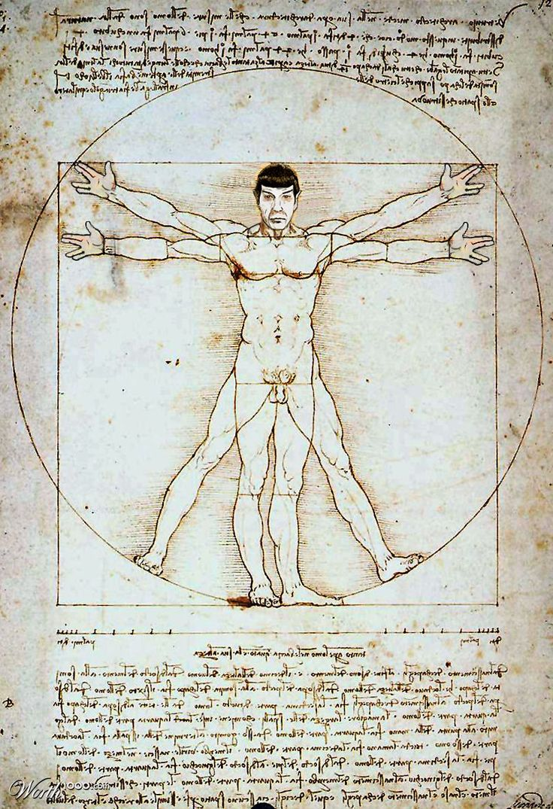
Episode III: Idiomatic Spock

Slide 41
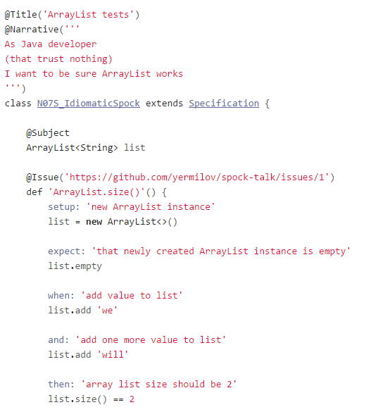
Episode III:
Idiomatic Spock

Slide 42
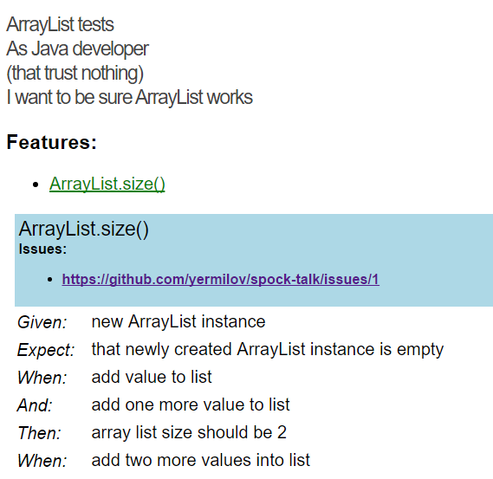
Episode III:
Idiomatic Spock
github.com/renatoathaydes/spock-reports

Slide 43
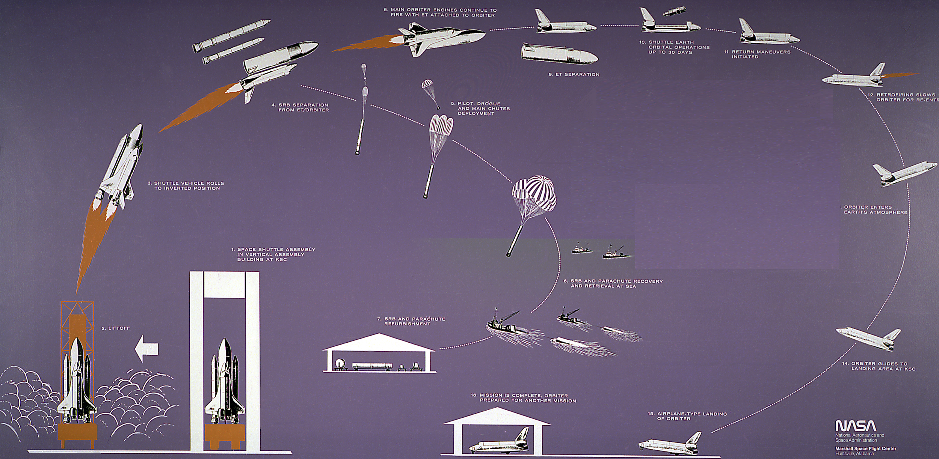
Episode IV:
Setup/Teardown

Slide 44
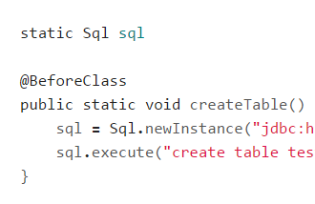
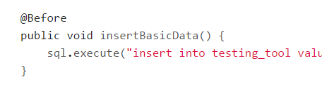
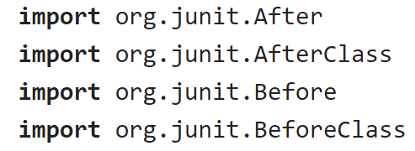
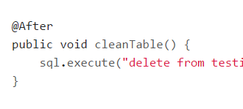
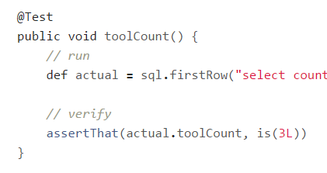

Episode IV: Setup/Teardown

Slide 45




Episode IV: Setup/Teardown

Slide 46






Episode IV: Setup/Teardown

Slide 47





Episode IV: Setup/Teardown

Slide 48


Episode IV: Setup/Teardown

Slide 49

Episode IV: Setup/Teardown

Slide 50


Episode IV: Setup/Teardown

Slide 51





Episode IV: @Shared or static?

Slide 52

Episode V:
Data driven test

Slide 53

Episode V: Data driven test

Slide 54

Episode V: Data driven test

Slide 55

Episode V: Data driven test

Slide 56

Episode V: Data driven test

Slide 57

Episode V: Data driven test

Slide 58

Episode V: Data driven test

Slide 59

Episode V: Data driven test

Slide 60

Episode V: Data driven test

Slide 61

Episode VI:
Exceptions

Slide 62

Episode VI: Exceptions

Slide 63

Episode VI: Exceptions

Slide 64

Episode VI: Exceptions

Slide 65

Episode VI: Exceptions

Slide 66

Episode VI: Exceptions

Slide 67

Episode VI: Exceptions

Slide 68

Episode VI: Exceptions

Slide 69

Episode VI: Exceptions

Slide 70

Episode VI: Exceptions

Slide 71

Episode VII:
Mocks,
Stubs,
Spies

Slide 72


Episode VII: Mocks, Stubs, Spies

Slide 73

Episode VII: Mocks, Stubs, Spies

Slide 74


Episode VII: Mocks, Stubs, Spies

Slide 75

Episode VII: Mocks, Stubs, Spies

Slide 76

Episode VII: Mocks, Stubs, Spies

Slide 77


Episode VII: Mocks, Stubs, Spies

Slide 78

Episode VII: Mocks, Stubs, Spies

Slide 79

Episode VII: Mocks, Stubs, Spies

Slide 80

Episode VII: Mocks, Stubs, Spies

Slide 81

Episode VII: Mocks, Stubs, Spies

Slide 82

Episode VIII: Time travel

Slide 83

Episode VIII: Time travel

Slide 84
Episode VIII: Time travel

Slide 85


Episode VIII: Time travel

Slide 86

Episode VIII: Time travel

Slide 87

Episode VIII: Time travel

Slide 88

Episode VIII: Time travel

Slide 89

Episode VIII: Time travel

Slide 90


Episode VIII: Time travel

Slide 91

Episode VIII: Time travel

Slide 92


Episode VIII: Time travel

Slide 93

Episode IX:
Test control

Slide 94



Episode IX: Test control

Slide 95

Episode IX: Test control

Slide 96
Episode IX: Test control

Slide 97

Episode IX: Test control

Slide 98

Episode IX: Test control

Slide 99

Episode IX: Test control

Slide 100

Episode IX: Test control

Slide 101

Episode IX: Test control

Slide 102

Episode IX: Test control

Slide 103


Episode IX: Test control

Slide 104

Episode IX: Test control

Slide 105



Episode IX: Test control

Slide 106

Episode X: Encore

Slide 107

Episode X: Encore

Slide 108

Episode X: Encore

Slide 109

Episode X: Encore

Slide 110

Episode X: Encore

Slide 111

Episode X: Encore

Slide 112

Episode X: Encore

Slide 113

Episode X: Encore

Slide 114

Why one should use Spock?

Slide 115

Concise syntax

Slide 116

Language for testing instead of testing struggling language

Slide 117

Clear test structure

Slide 118

Code and reports readable for everyone

Slide 119

Powerful built-in features

Slide 120

Extensions

Slide 121

Useful for unit, integration and functional tests

Slide 122


Behaves as one more JUnit runner

Slide 123

Works for both Groovy and Java

Slide 124

Why one should not use Spock?

Slide 125

JUnit/TestNG has 90% similar/imitable features

Slide 126



Spock lost its lead developer

Slide 127

When one can use Spock?

Slide 128

Your team is ready to make one step forward

Slide 129

You are about to start new project

Slide 130

You want to cover legacy project with unit tests

Slide 131

You want to introduce functional testing in your project

Slide 132
What’s next?
Spock documentation
Spock source repositories
Spock examples project
Spock smoke tests
Spock Web Console
Spock reports

Slide 133
What’s next?
mrhaki about Spock
Spock vs JUnit by Kostis Kapelonis and Athens Greece
Smarter testing Java code with Spock Framework by Marcin Zajączkowski
Idiomatic Spock by Rob Fletcher
Spock: A Logical Framework for Enterprise Testing by Ken Kousen

Slide 134
What’s next?
Java Testing with Spock by Konstantinos Kapelonis
Geb documentation
Geb for browser automation by Jacob Aae Mikkelsen
https://twitter.com/yermilov17
https://www.facebook.com/yaroslav.yermilov
https://ua.linkedin.com/pub/yaroslav-yermilov/58/682/506

Slide 135

Thanks!

